Slide 1
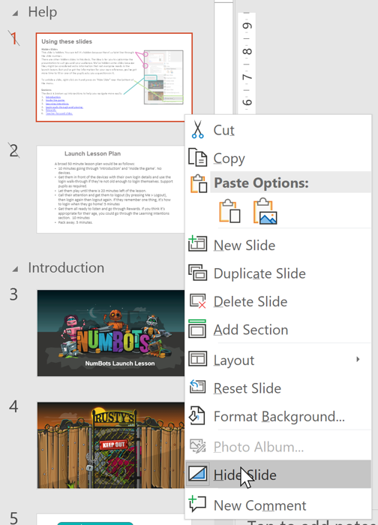
Using these slides
Hidden Slides
This slide is hidden. You can tell it’s hidden because there’s a faint line through the slide number.
There are other hidden slides in this deck. The idea is for you to customise the presentation to suit you and your audience. We’ve hidden some slides because they might be considered extra information that not everyone needs in the launch lesson. But you’ve got the information for your own reference, or if you’ve got more lesson time available or if one of the pupils asks you a question on it.
To unhide a slide, right click on it and press on “Hide Slide” near the bottom of the menu.
Sections
The deck is broken up into sections to help you navigate more easily. Download the accompanying Launch Lesson Plan which summarises how to use each section and will support your launch lesson.
Menu
Use the menu to take you to the relevant sections. You can click on the [Menu] link in the top right of every screen to return to the menu.

Slide 2
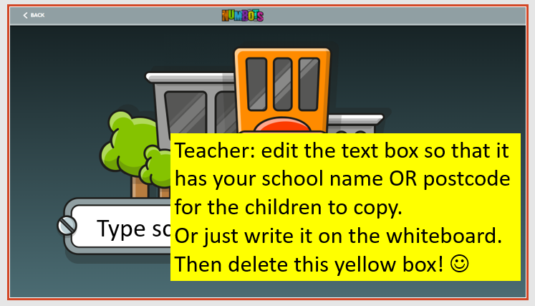
ATTENTION!
Please enter your school name or postcode in the text box on slide 26 for the children to copy when logging in for the first time.

Slide 3
Before you begin
Read the Launch Lesson Plan.
Install NumBots app on school tablets or open play.numbots.com on computers/laptops. If using the browser, we recommend using Google Chrome. Ensure *.numbots has been whitelisted by your network/IT person.
To save time during the lesson, bookmark your school’s log in page so that pupils can skip the steps on slides 19-22.
Print and cut out username labels to hand out to pupils.
Print parent letters to distribute on day of launch.

Slide 4
Launch Lesson Plan
A broad 50 minute lesson plan would be as follows:
Start with pupils away from devices and go through first three sections of presentation (slides 6-16) to introduce them to NumBots. (10 minutes)
Get pupils in front of the devices with their own login details. Use the ‘Logging in’ and ‘Choose a bot’ sections (slides 17-28) to get pupils started. (5 minutes)
Let pupils play until there is 20 minutes left of the lesson. (approx. 15 minutes)
Get pupils to log out, then log in again then log out again. If they remember one thing, it’s how to log in when they get home! (5 minutes)
Get pupils ready to listen and go through ‘Still to come’ section (slides 44-53). Go through the ‘Learning Intentions’ section (slides 54-57) if you think it’s appropriate for their age. (10 minutes)
Pack away. (5 minutes)
1
2
3

Slide 5

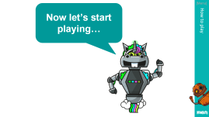




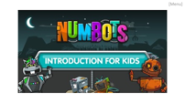
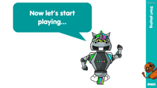
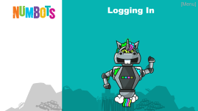
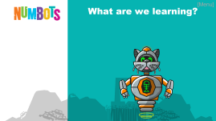
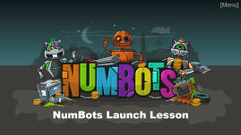


Launch Lesson Plan – Slide Menu
Before pupils use NumBots
At the point pupils start on NumBots
After pupils have played on NumBots
10 mins
20 mins inc play
20 mins inc pack away
1
10 minutes going through ‘Meet the NumBots’ and ‘Introducing the game’.
No devices.
2
Get them in front of the devices with their own login details and use the ‘Logging in’ and ‘How to play’ if they’re not old enough to login themselves. Support pupils as required.
Let them play until there is 20 minutes left of the lesson.
Call their attention and get them to logout (by pressing Me > Logout), then login again then logout again. 5 minutes
3
Get them all ready to listen and go through ‘Rewards’. If you think it’s appropriate for their age, you could go through the ‘Learning Intentions’ section. 10 minutes
Pack away. 5 minutes.

Slide 6
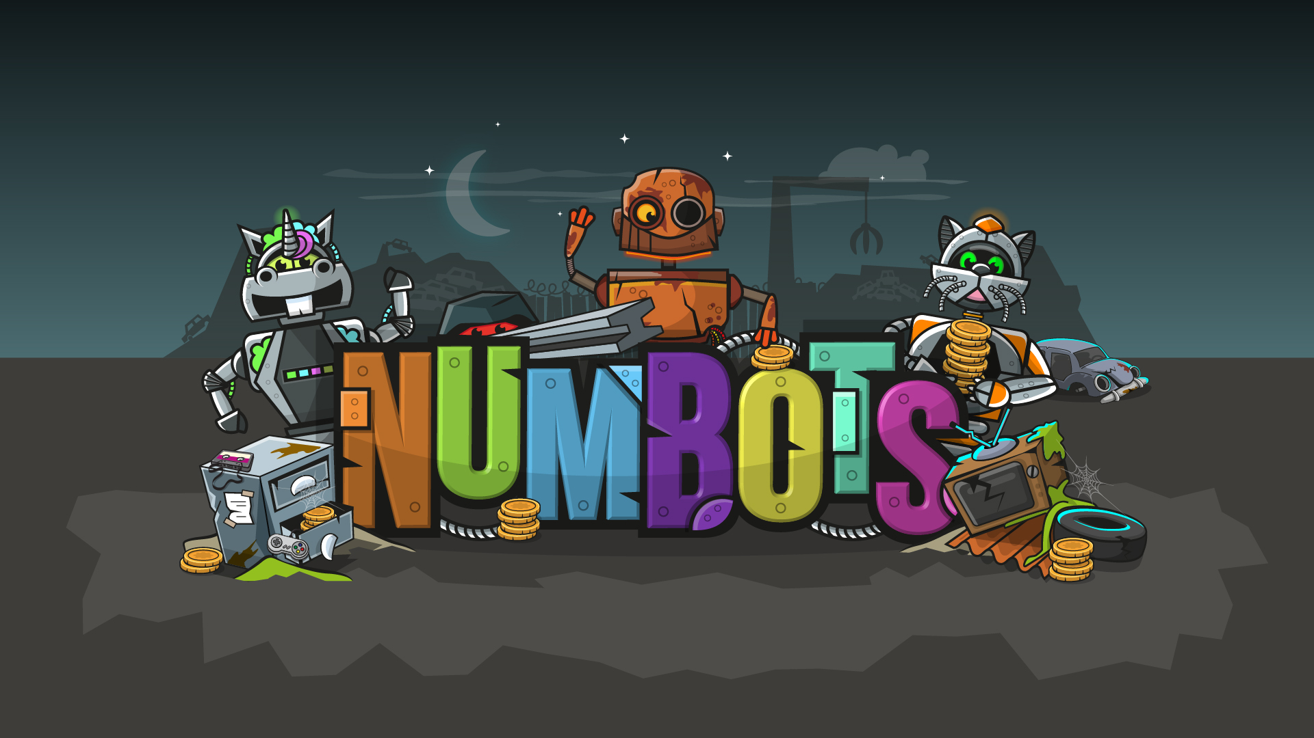
[Menu]
NumBots Launch Lesson
Notes:
Start the launch session with the children sat away from the computers/tablets, so they aren’t distracted by the devices. (At slide 16 they’ll move to their devices – but we’ll remind you, don’t worry!)

Slide 7
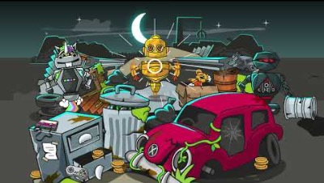
[Menu]
Notes:
In this 1 minute video, we meet Rusty (the protagonist in NumBots) and some of his robot friends.
Play this video at the start of the launch session to get your pupils excited about NumBots and curious to find out more.
Press play to start the video. You may need to wiggle the cursor. If your computer is struggling, here’s the video on YouTube: https://youtu.be/AeO2u2bSD6A

Slide 8


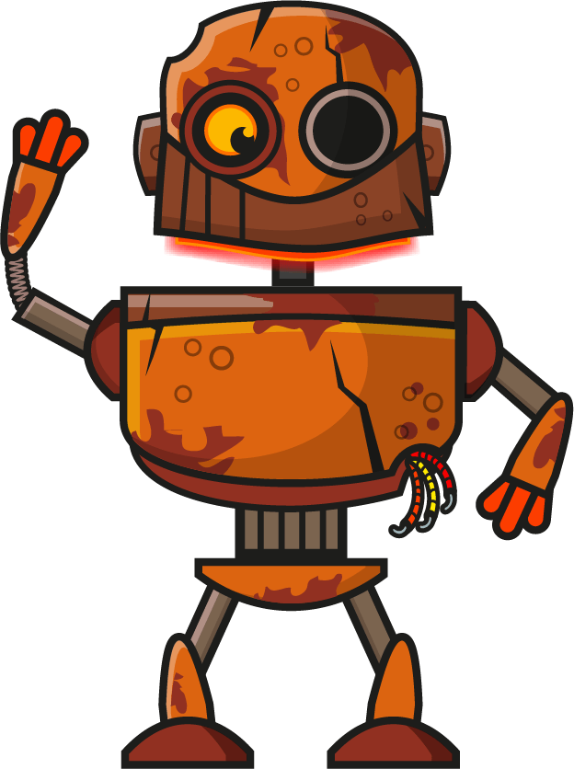




[Menu]
Would you like to watch that again?

Slide 9
[Menu]
What can you remember from that story?
Notes:
You can take hands up, use cold call* or use partner talk to elicit responses.
* Children keep their hands down and you choose someone.

Slide 10



[Menu]
I’m UnicornBot.
Remember my friends?
I’m KittyBot.
I’m NinjaBot.
Notes:
Before revealing each name you could get them to call out the name together.
e.g. “After 3, what’s the name of this bot [pointing to Unicorn]? 1…2…3…”

Slide 11
[Menu]
I’m looking for spare parts to _ _ _ _ _ _ _ myself.
Can you think of other words for ‘upgrade’?
u p g r a d e
Notes:
Improve, make better, use new parts, get shiny, etc

Slide 12
[Menu]
I want to shine inside and out.
What do you think I mean?
Notes:
This is a good one for partner talk.
e.g. “Discuss what you think this means with your partner for 15 seconds.”
Shining inside and out…wanting to have a good personality, to be kind/nice/friendly/good as well as being strong, shiny, clean, working, etc on the outside.

Slide 13

[Menu]
Shall we take a closer
look at ?

Slide 14
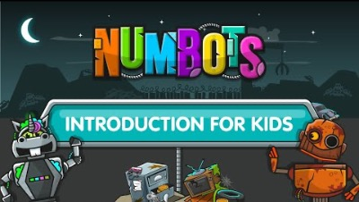
[Menu]
Notes:
In this 2 minute video, pupils are introduced to the NumBots platform, so they know what to expect when they start playing.
Press play to start the video. You may need to wiggle the cursor. If your computer is struggling, here’s the video on YouTube: https://youtu.be/nEtVaPpWSQo

Slide 15
[Menu]
Would you like to watch that again?

Slide 16
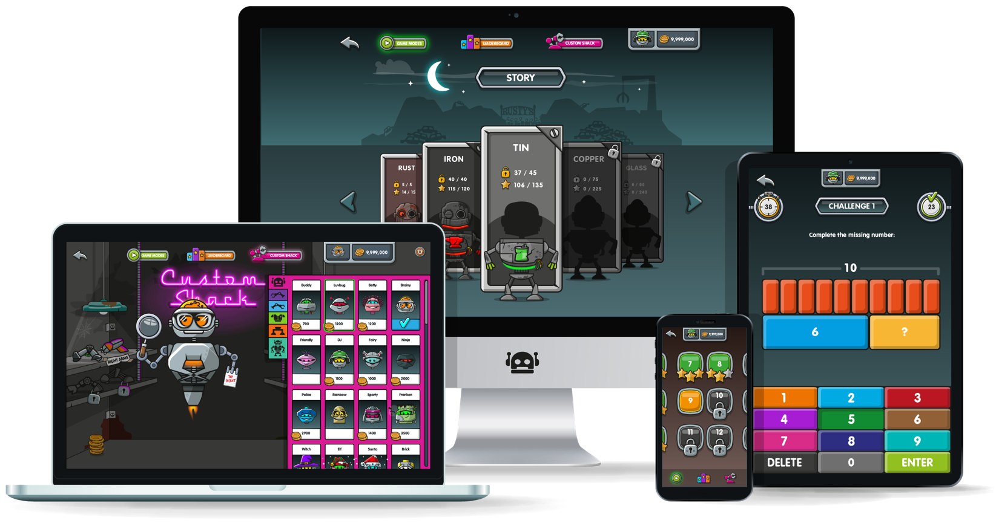


There are lots of ways to play NumBots…
[Menu]
… so you can play at school and at home!
100
Notes:
Children can play NumBots on lots of different devices.
Teacher to inform pupils what type of devices they will be using today in class, and to inform children that they can also log in and play at home on a computer/laptop, or via the mobile app on a tablet/smartphone.

Slide 17
[Menu]
Logging In
Notes:
At this point, it’s usually a good time to get the pupils logging in.
They need to navigate to play.numbots.com or open the NumBots app on mobile devices. Then click through the slides to show them how to log in.

Slide 18
[Menu]
Watch closely so that you know what to do.
Logging In
Notes:
Depending on the age of your pupils, you may need to walk them through everything on the teacher screen first.
However, if they’re IT savvy enough, you could just tell them to log in and let them figure it out.

Slide 19
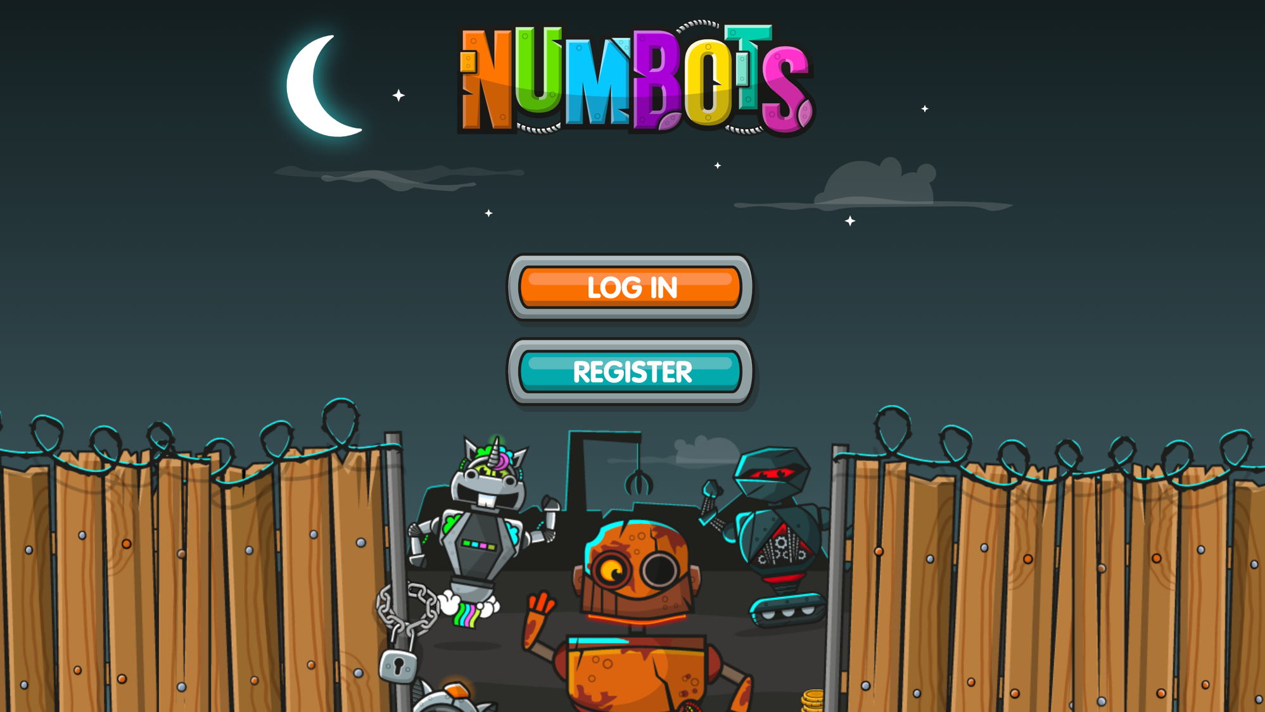

[Menu]
Notes:
Pupils will click the orange “Log In” button.

Slide 20
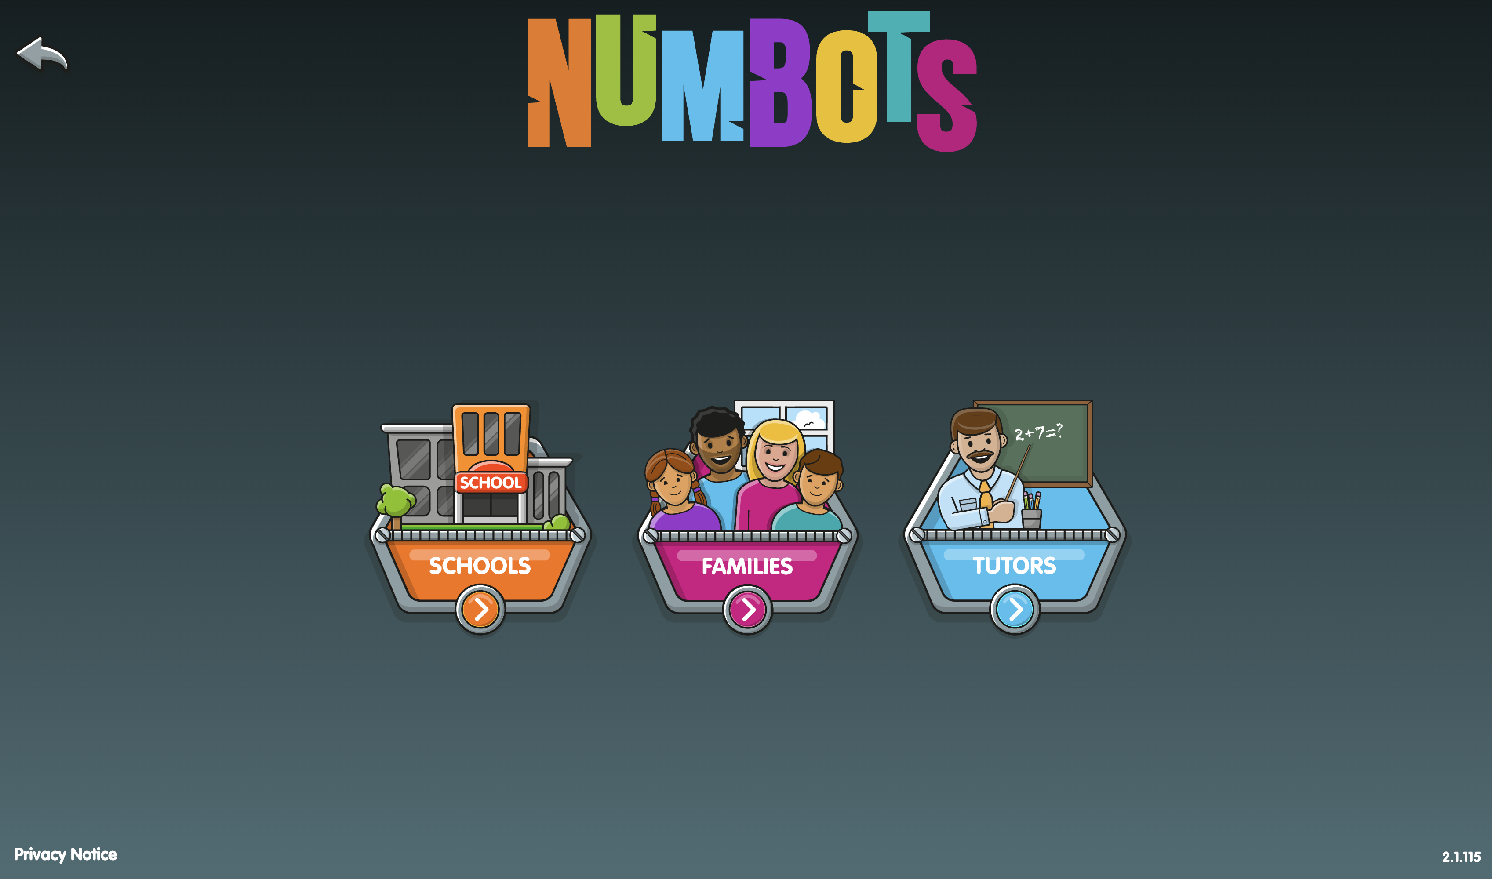
[Menu]
Notes:
Then they will click the orange “Schools” button.

Slide 21
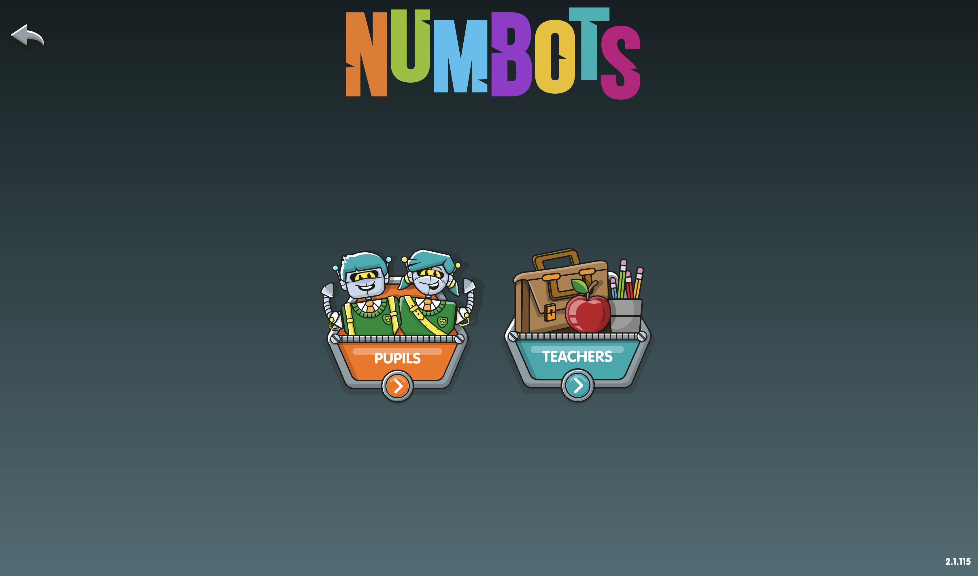
[Menu]
Notes:
Then they will click the orange “Pupils” button.

Slide 22
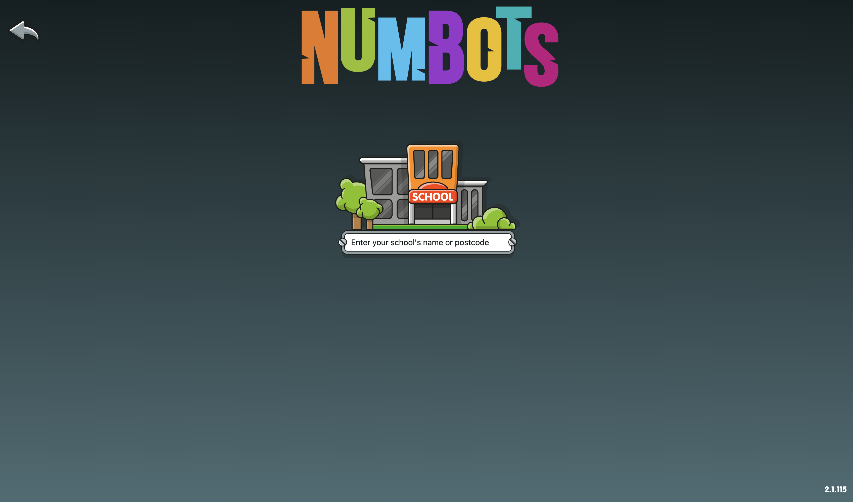

[Menu]
Type school name or postcode
Notes:
Pupils will start typing in the name or postcode of the school, then select it from the drop down list.

Slide 23
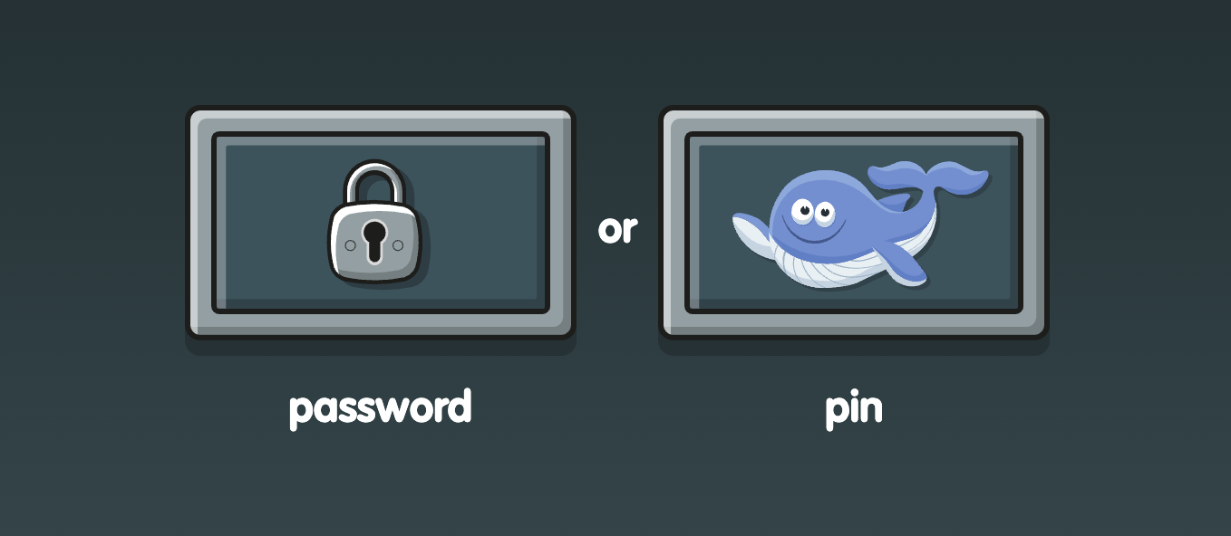
Which icon is on your username label?
[Menu]
Logging In
Notes:
Each pupil will log in using a password or animal PIN. (You chose which when you downloaded the username labels.) Show the children which button they will select to log in. Click the correct button on the screen yourself.

Slide 24
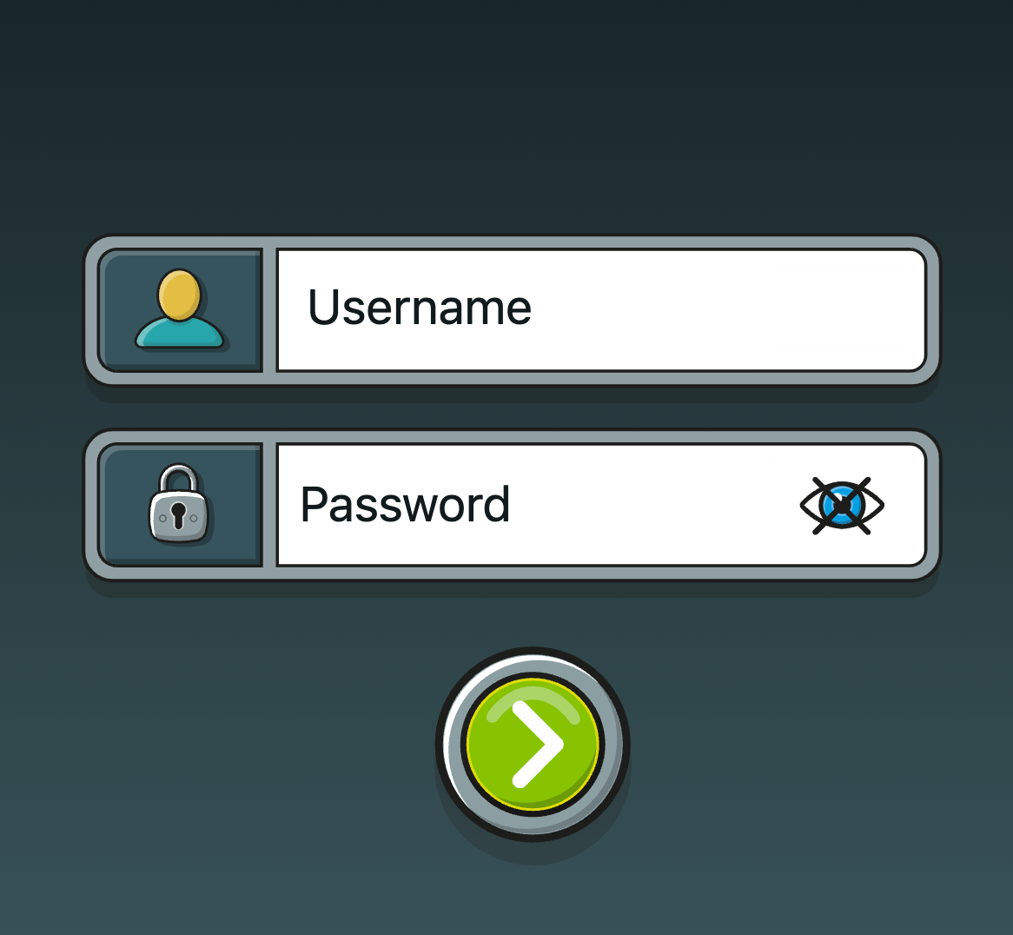
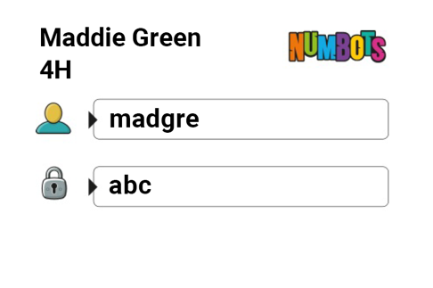
[Menu]
Example label
madgre
Logging In
abc
Your turn!
Notes:
Now pupils will enter their individual log in details. Now is a good time to give out their username labels which contain their username and password.

Slide 25
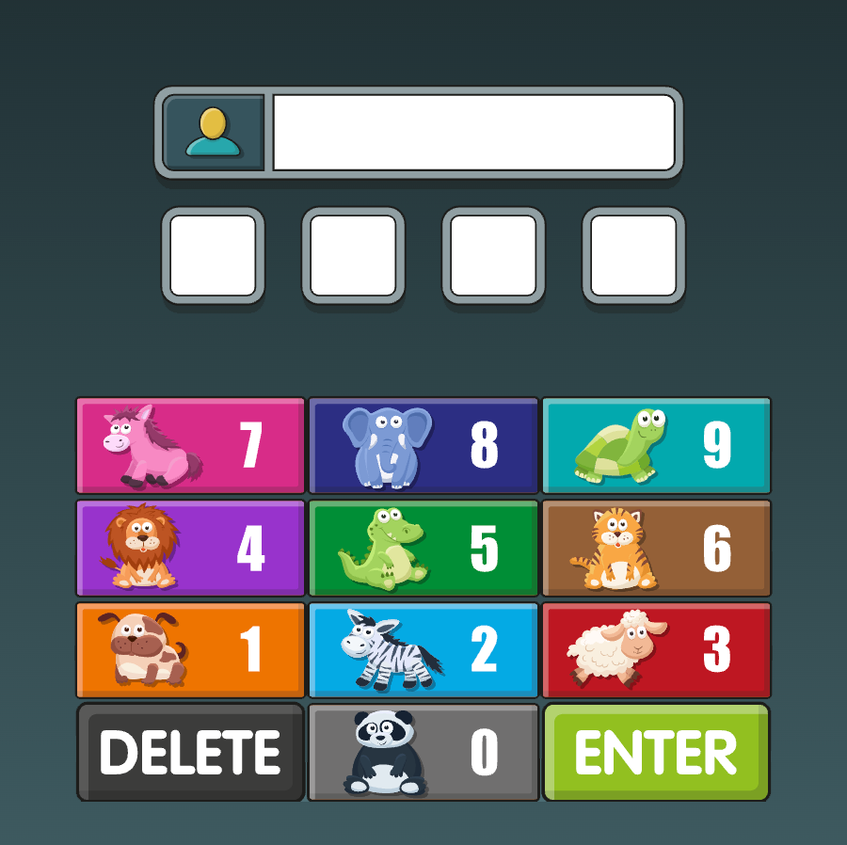
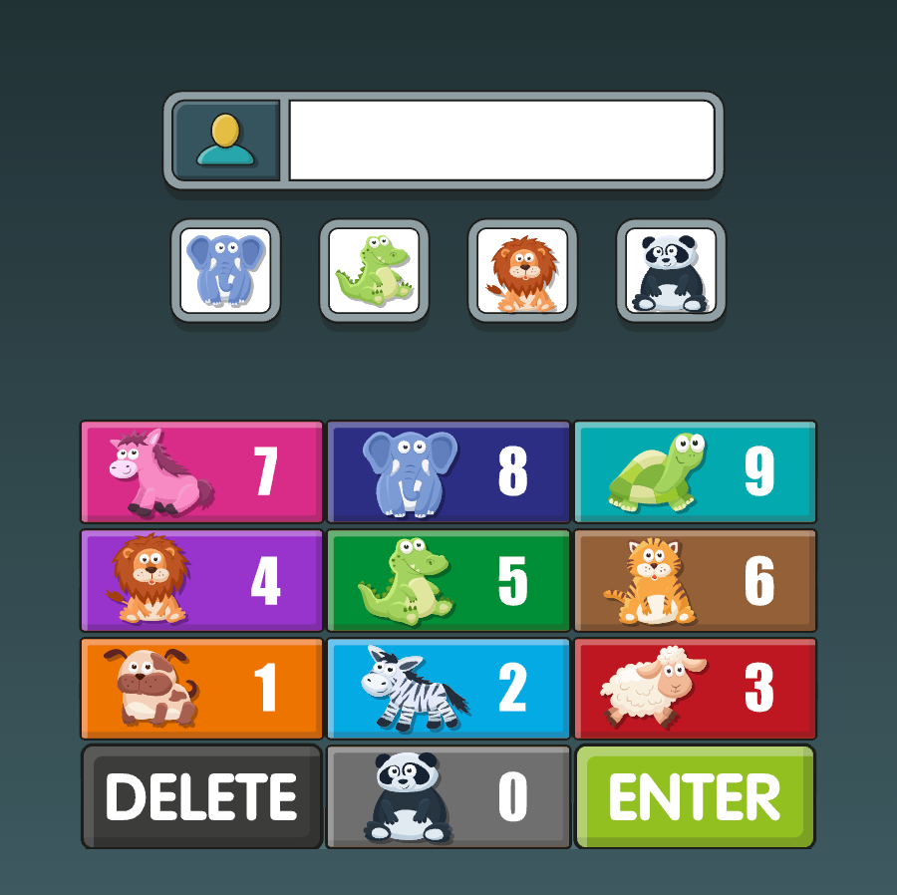
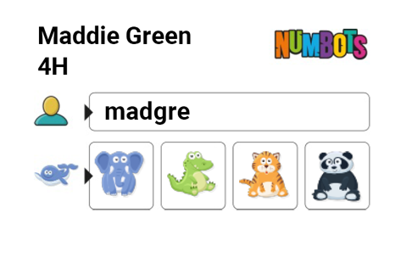
[Menu]
madgre
Example label
Logging In
Your turn!
Notes:
Now pupils will enter their individual log in details. Now is a good time to give out their username labels which contain their username and PIN.

Slide 26
[Menu]
Teacher: edit the text box so that it has your school name OR postcode for the children to copy.
Or just write it on the whiteboard.
Then delete this yellow box! ☺
Type school name or postcode
Notes:
Pause on this slide while the pupils log in. They may need your help entering their login details the first time they log in.

Slide 27
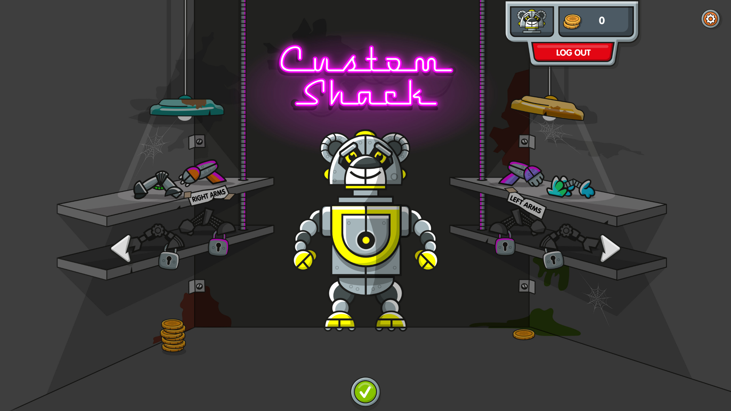
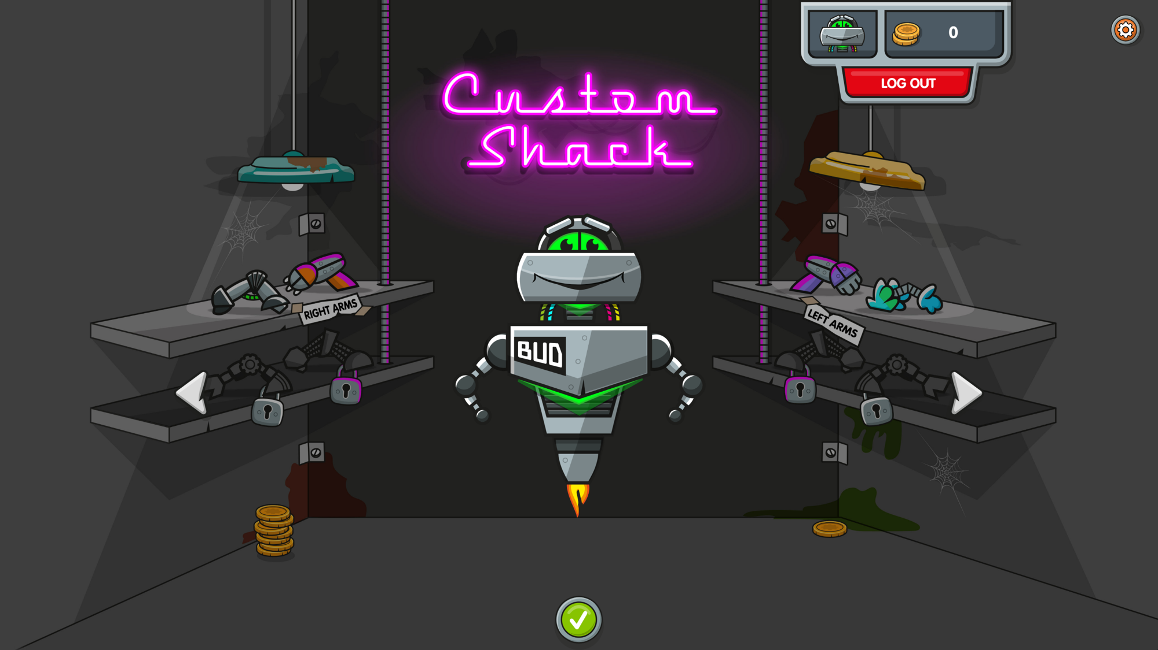
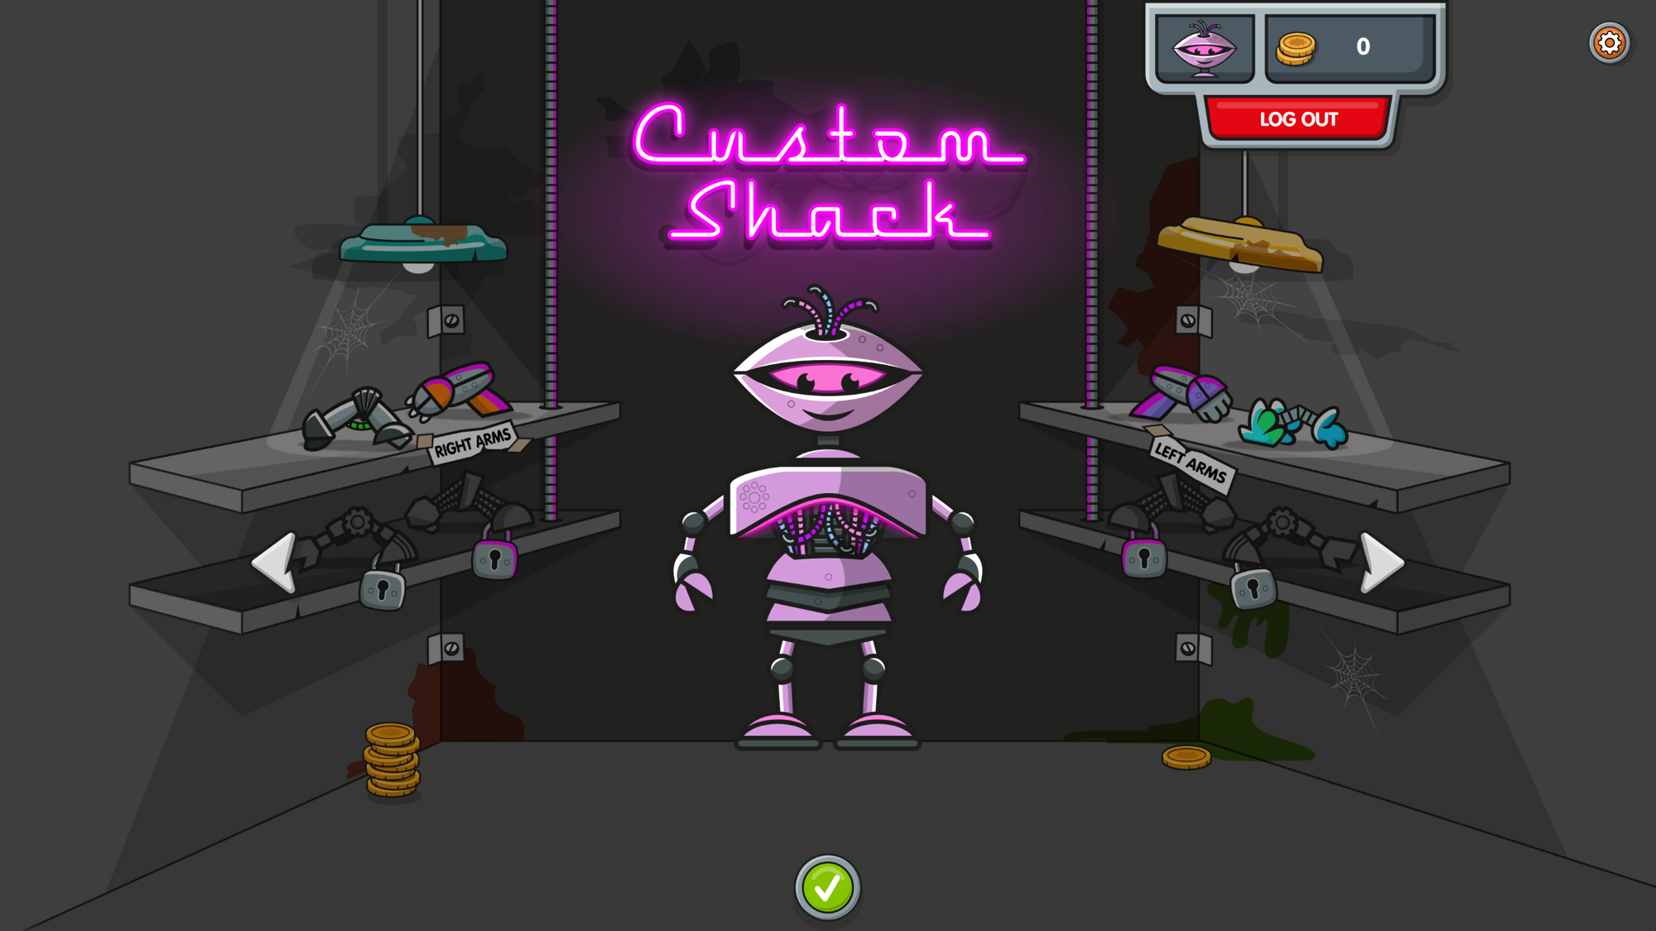
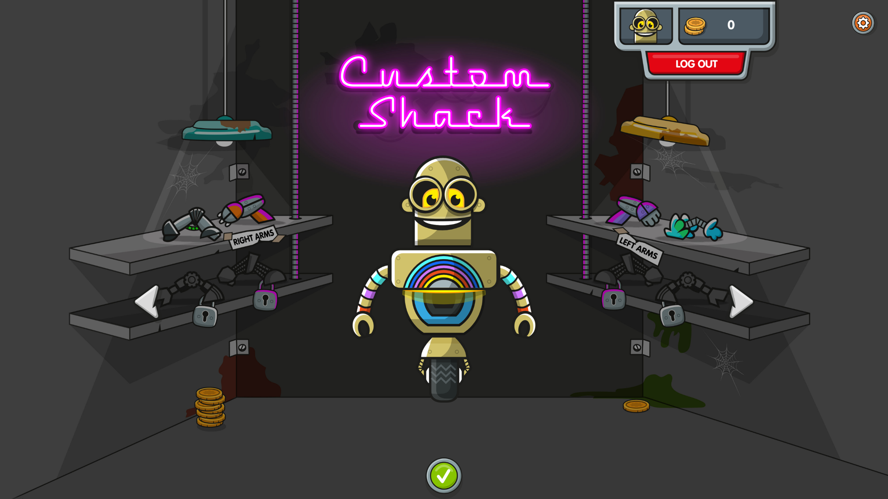
Choose your Bot…
[Menu]
Notes:
Once pupils have logged in, they’ll be able to choose their bot.
Once they have chosen their Bot, they cannot go back and change it. HOWEVER they will be able to customise their avatars in the Custom Shack once they’ve earned some coins.

Slide 28
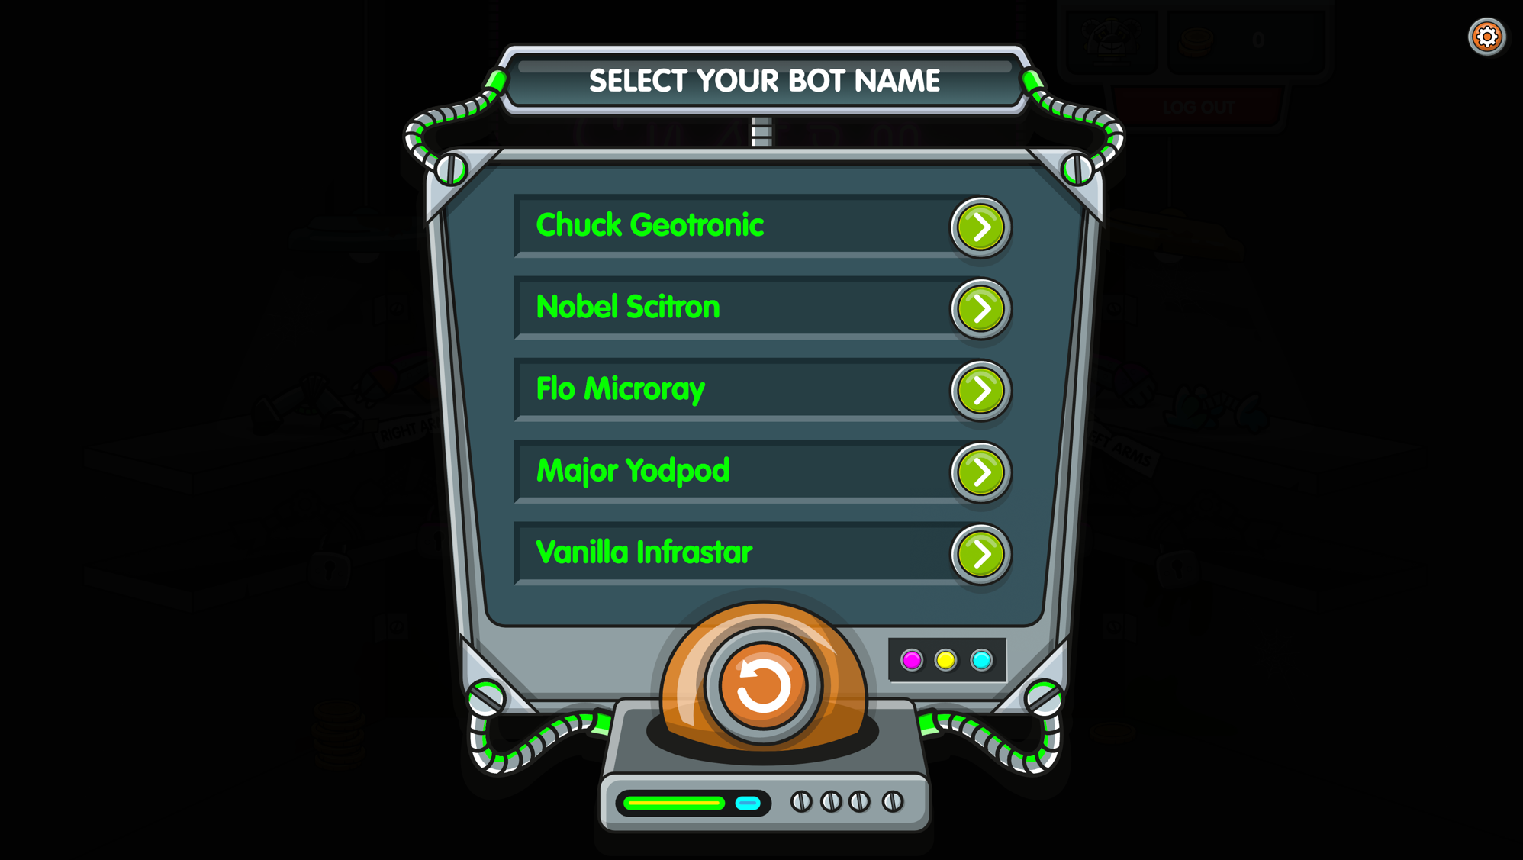
Pick your
Bot name!
[Menu]
Notes:
Pupils then pick themselves a bot name by pressing one of the green buttons. If they don’t like any of the five suggestions, press the orange button to see some different options.

Slide 29
[Menu]
Now let’s start playing…
How to play
Notes:
Depending on the age of your pupils, you may want to show them around the game using slides 30-40.
However, if they’re IT savvy enough, you might prefer to let them figure it out.

Slide 30
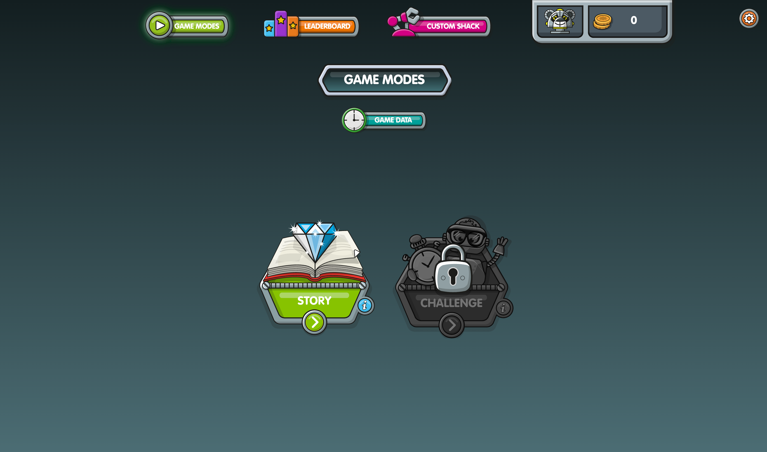
[Menu]
Press Story.
Notes:
There are two game modes: Story and Challenge. When you first play, Challenge mode is locked, so we’ll start in Story mode.
(You can click on the Challenge button in the game to find out which level Challenge mode unlocks at.)

Slide 31
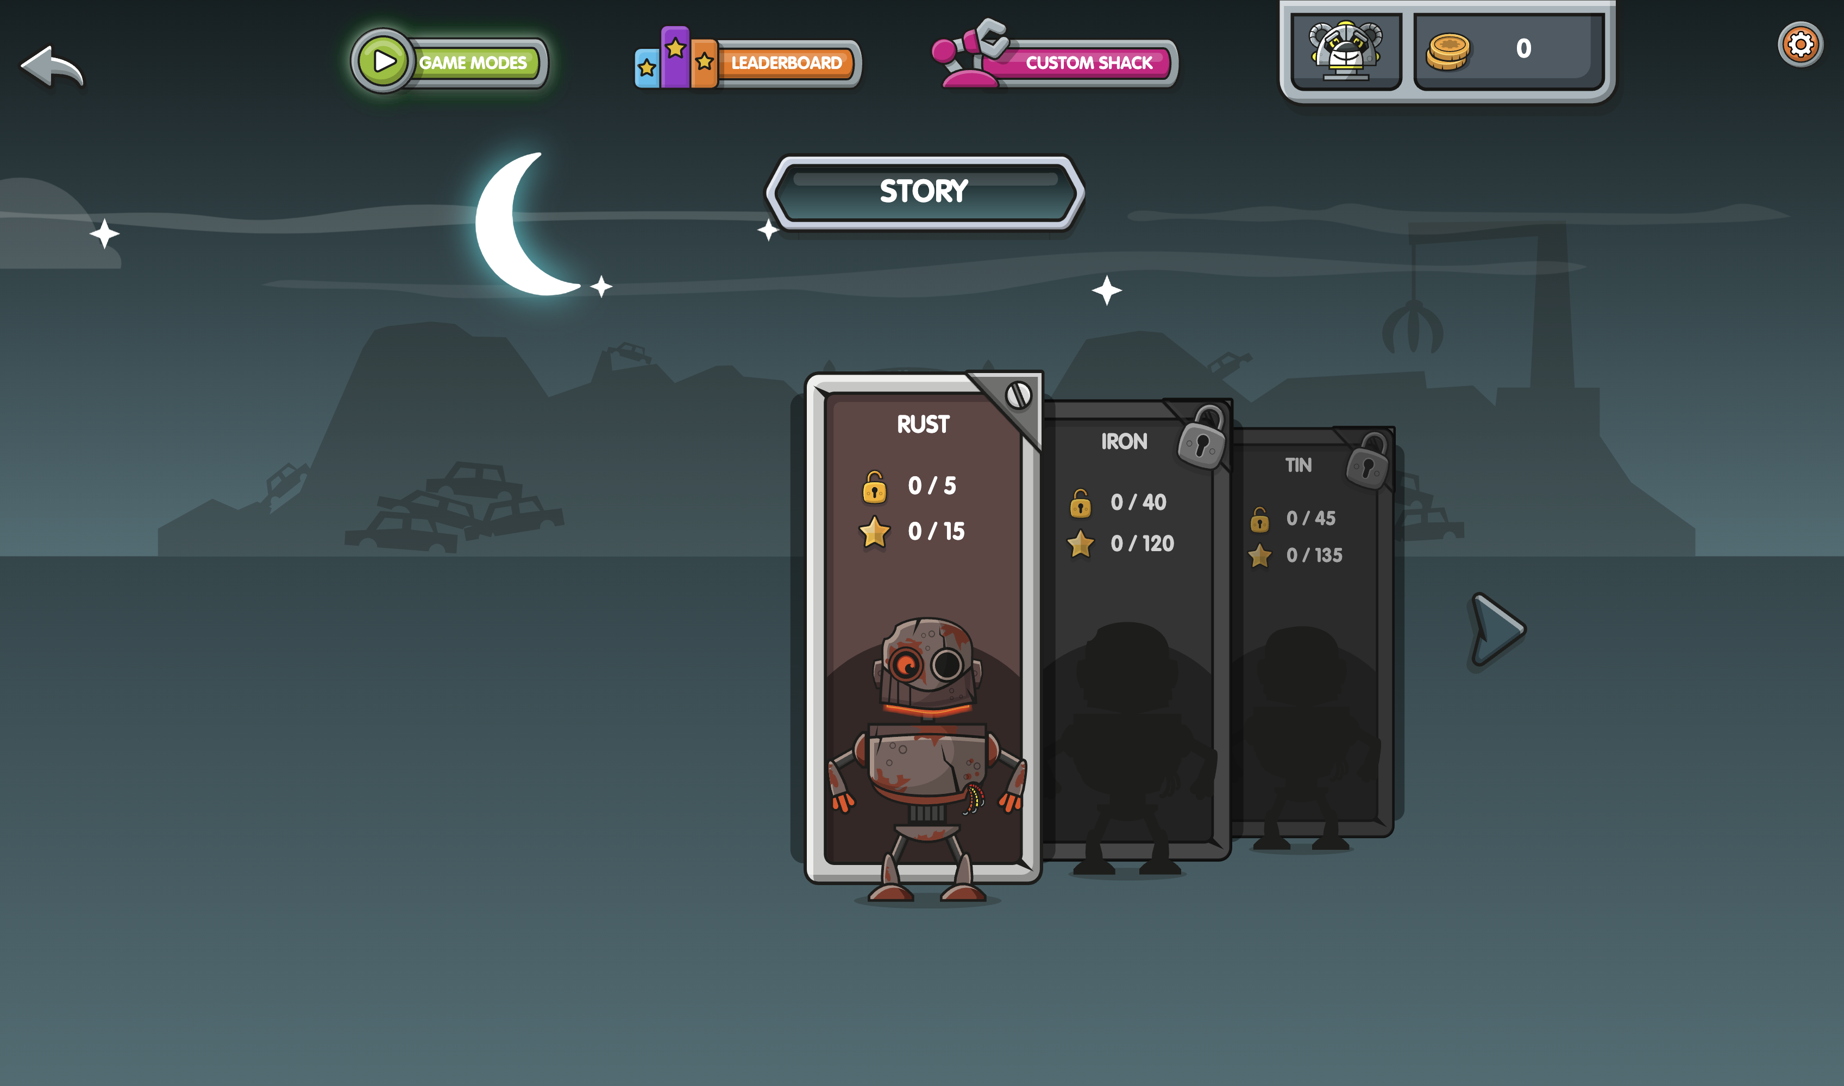
[Menu]
Press Rust stage.
Notes:
There are 18 stages altogether, to transform Rusty into a Diamond. You’ll start on Rust stage. Once you’ve completed Rust stage, you’ll unlock Iron stage.

Slide 32
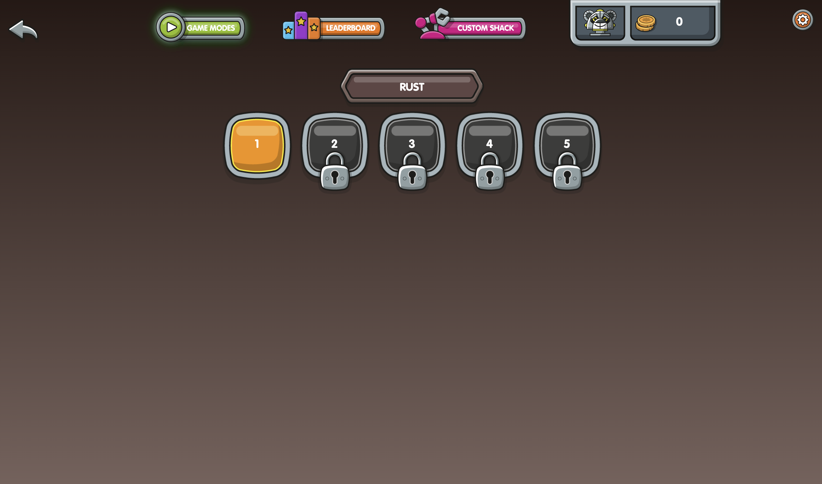
[Menu]
Press Level 1.
Notes:
Rust stage contains 5 training levels to familiarise pupils with the interface. If the levels have a padlock on them, it means they are locked for now. Start at level 1.

Slide 33
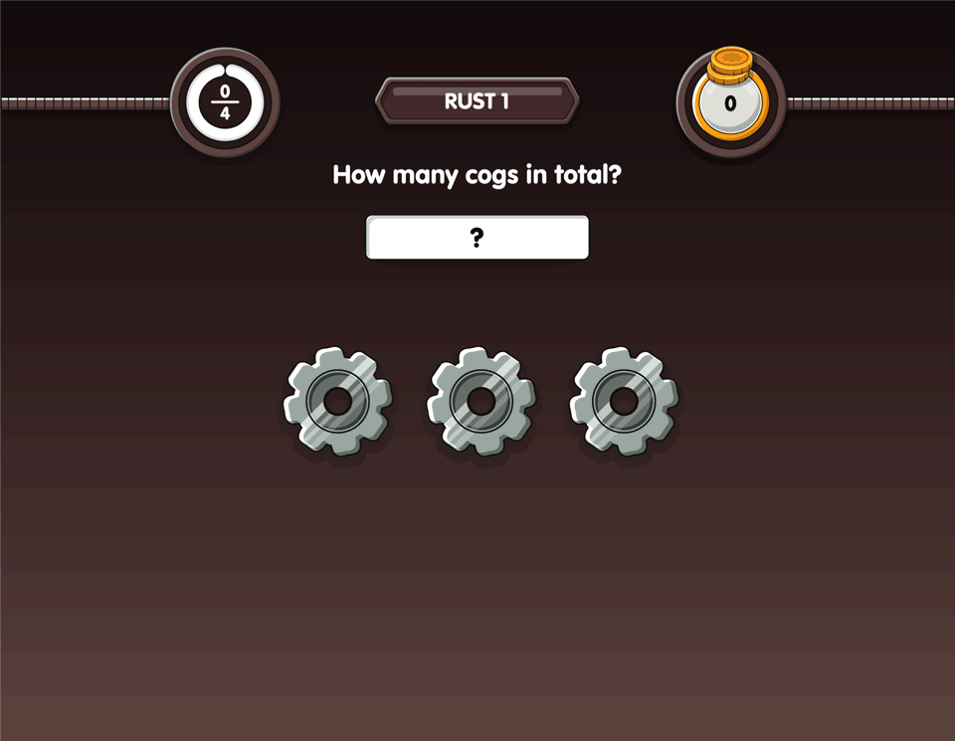
[Menu]
Notes:
The purpose of this animation is to show the pupils that you need to press Enter after each answer.

Slide 34
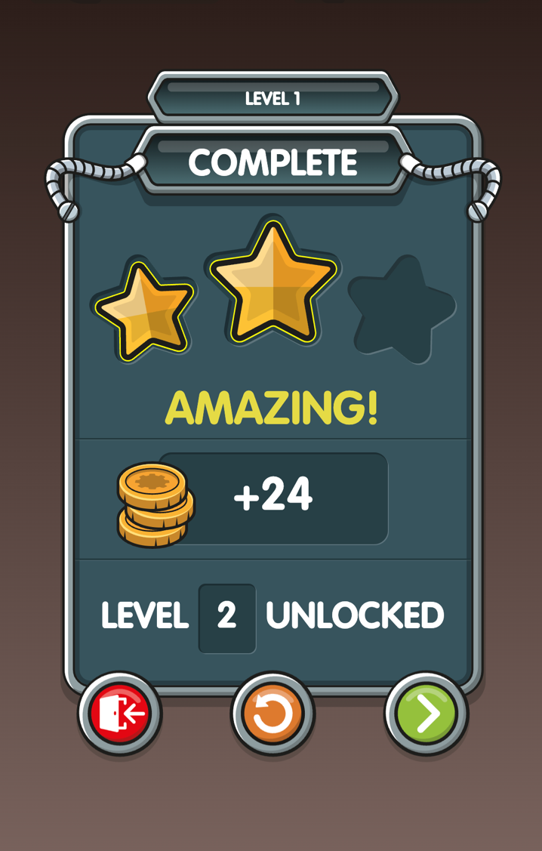
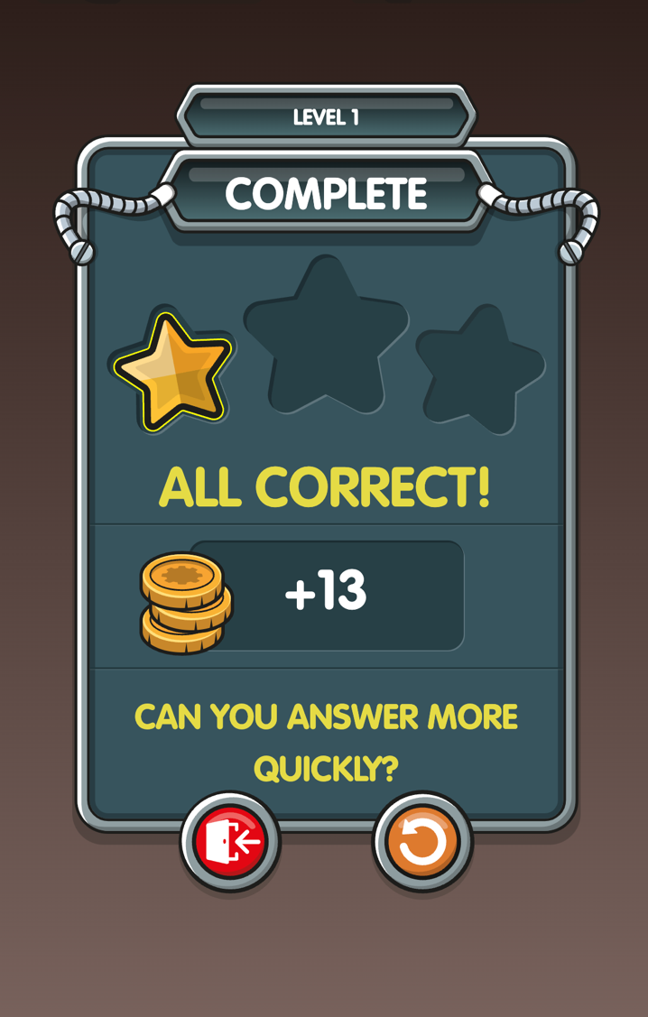
[Menu]
Therefore I need to have another go at that level.
That means I can play the next level!
At the end of the game you will see how many stars you have earned.
This time I scored 2 stars.
In this game I scored 1 star.
How to play
Notes:
Players need to score 2 or 3 stars to unlock the next level. If they score 0 or 1 star, they need to improve their accuracy or speed.

Slide 35
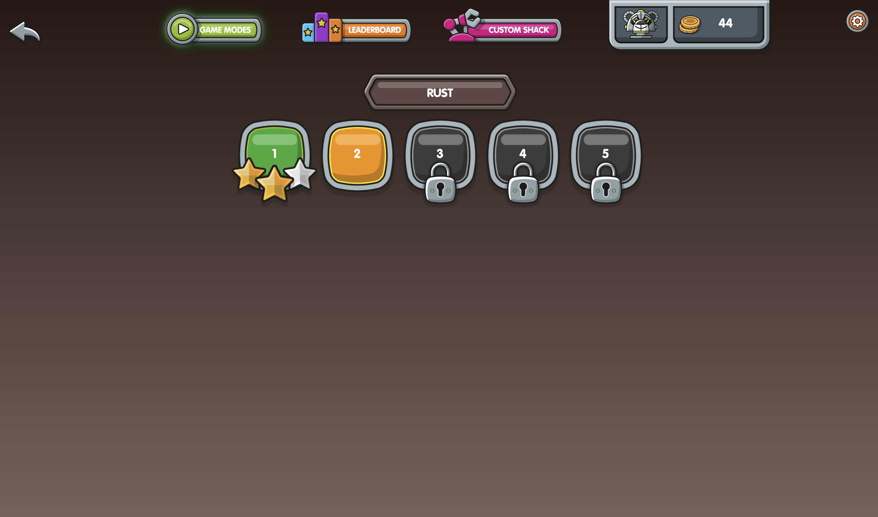
[Menu]
This is how Rust stage looks now.
Notes:
Level 3 is still locked because I only earned 1 star on level 2.
Feel free to skip this slide if you want to save time.

Slide 36
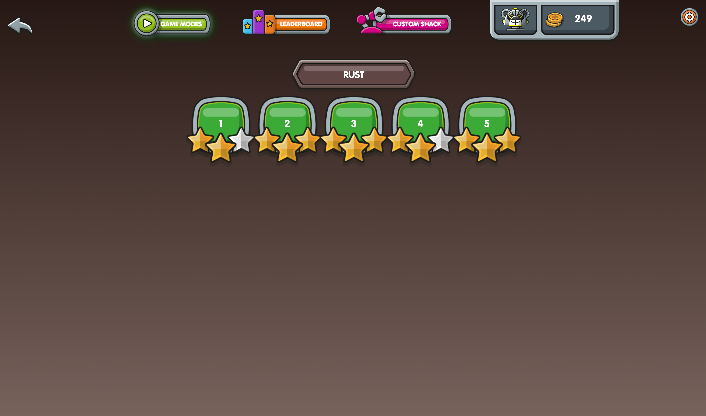
[Menu]
When you have passed all the levels…
Notes:
Feel free to skip this slide if you want to save time.

Slide 37
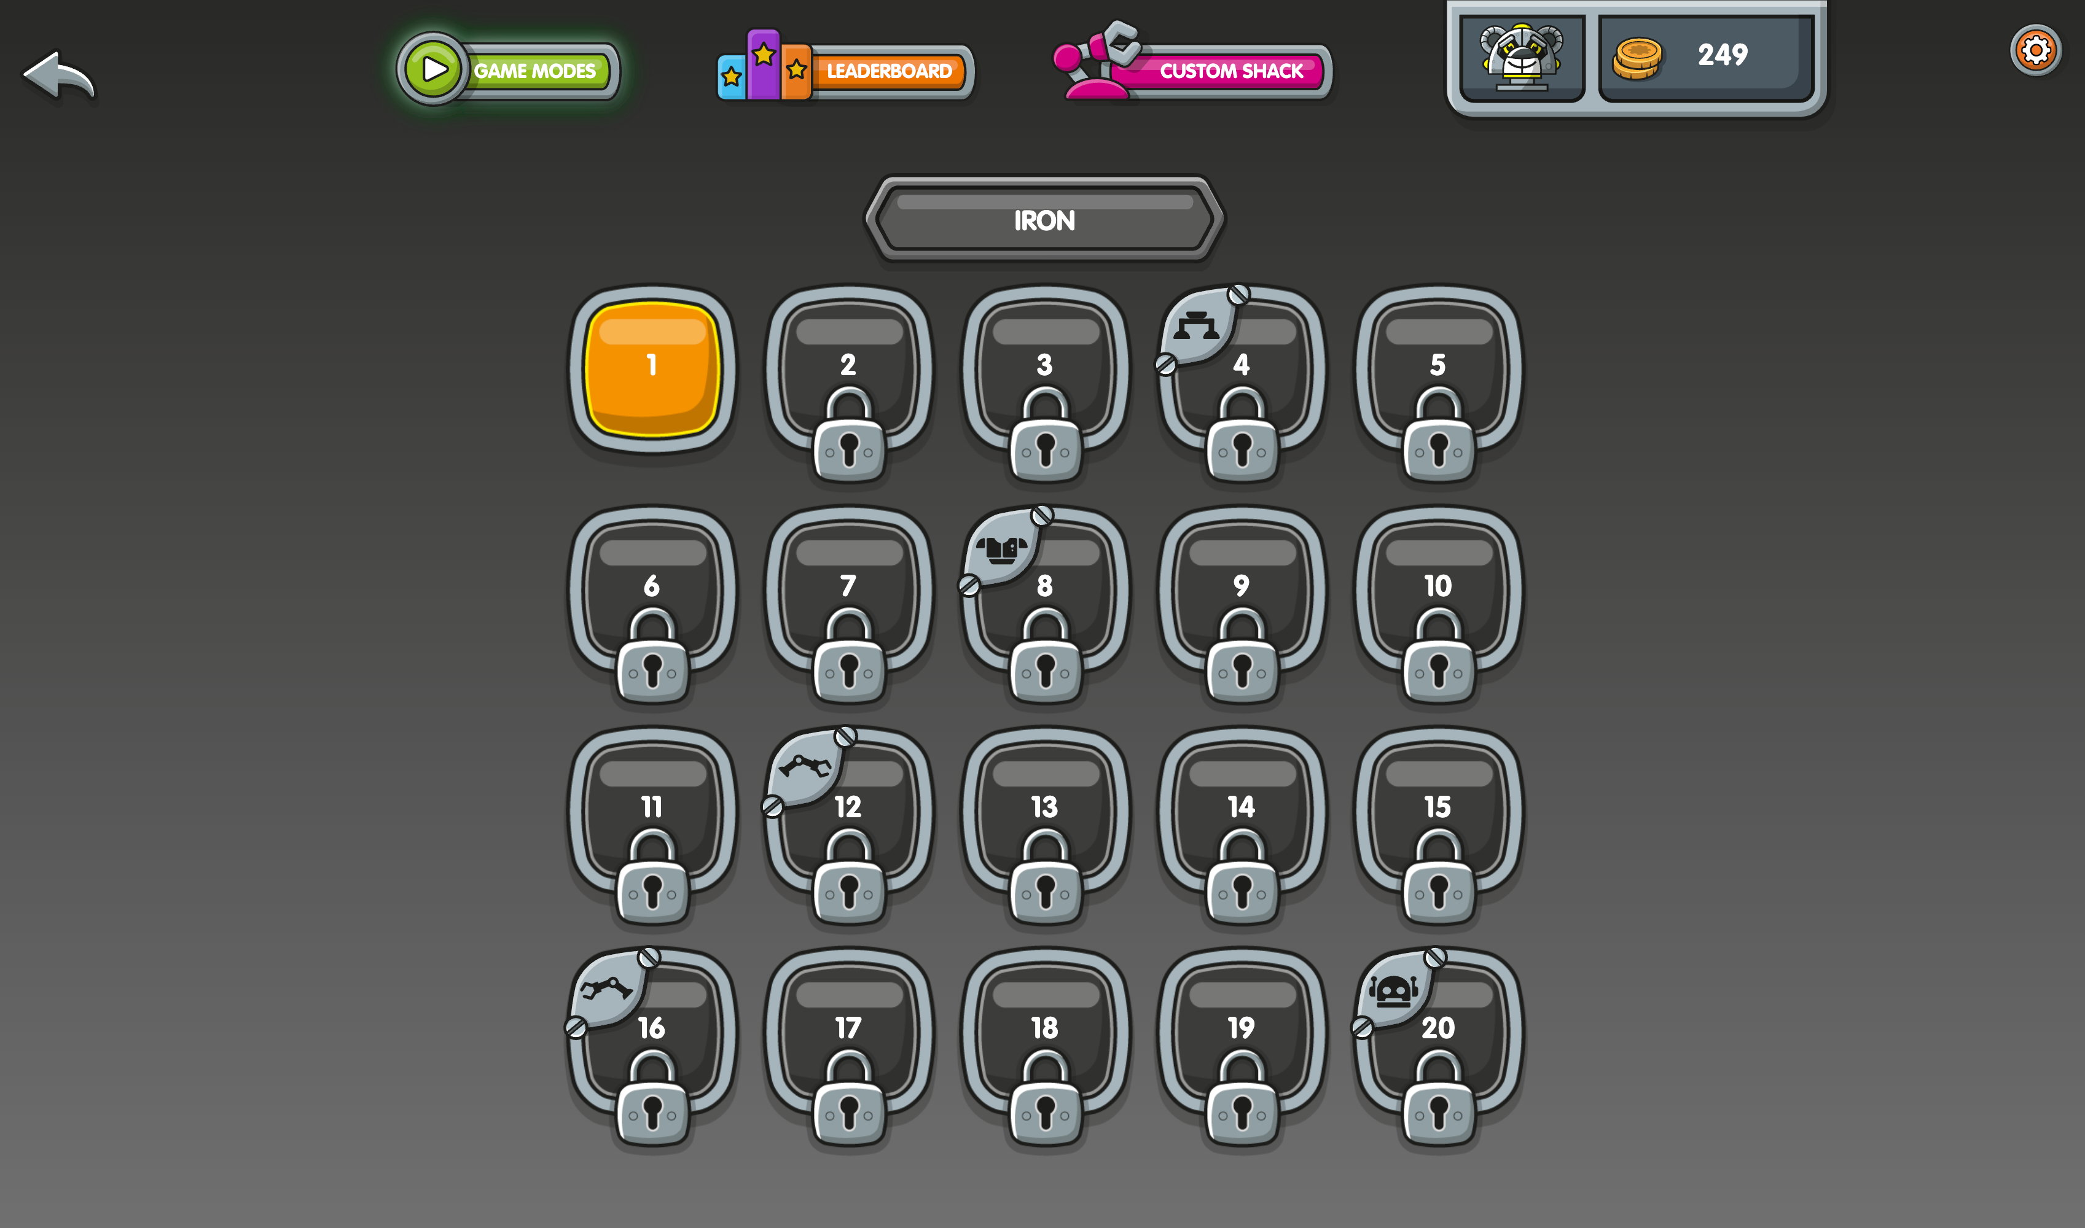
[Menu]
… you will unlock Iron stage!
There are lots of things to discover!
Notes:
Feel free to skip this slide if you want to save time.

Slide 38

Iron
[Menu]
Notes:
When certain levels are unlocked, the player earns a part to upgrade Rusty. The parts the children are collecting are evenly distributed throughout the stage.
Feel free to skip this slide if you want to save time.

Slide 39
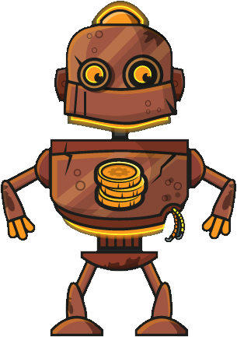
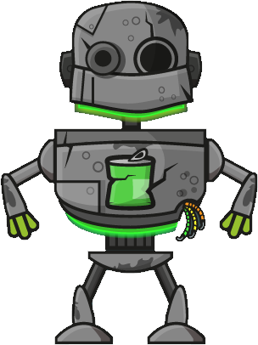
[Menu]
In every stage, you’ll find parts to upgrade Rusty…
Iron
Tin
Copper
Notes:
Here are examples of the parts that players unlock in the first stages.
Feel free to skip this slide if you want to save time.

Slide 40


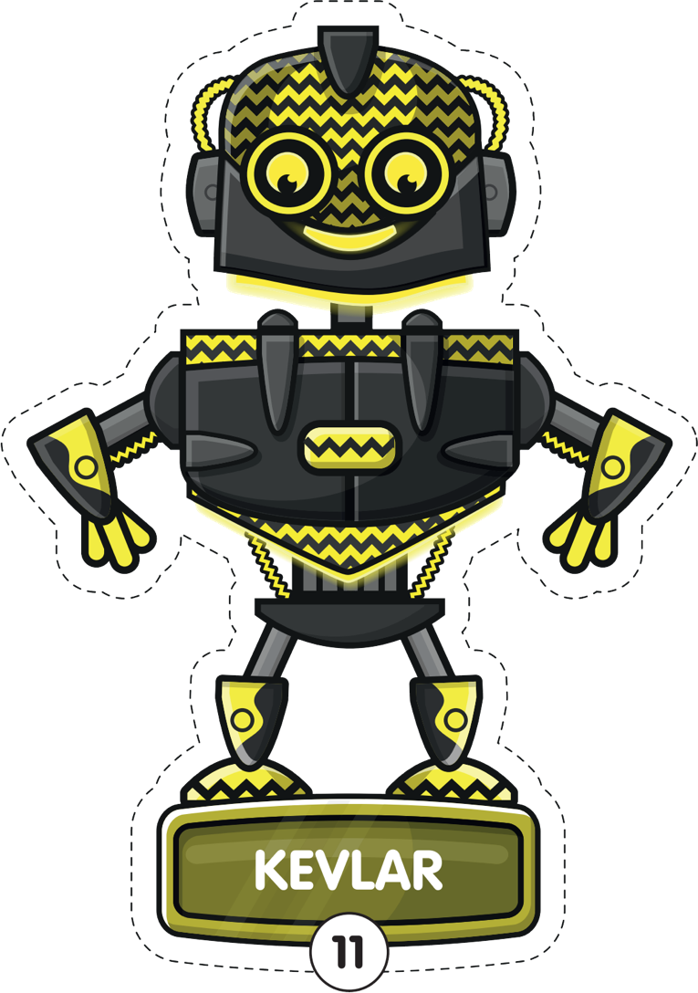
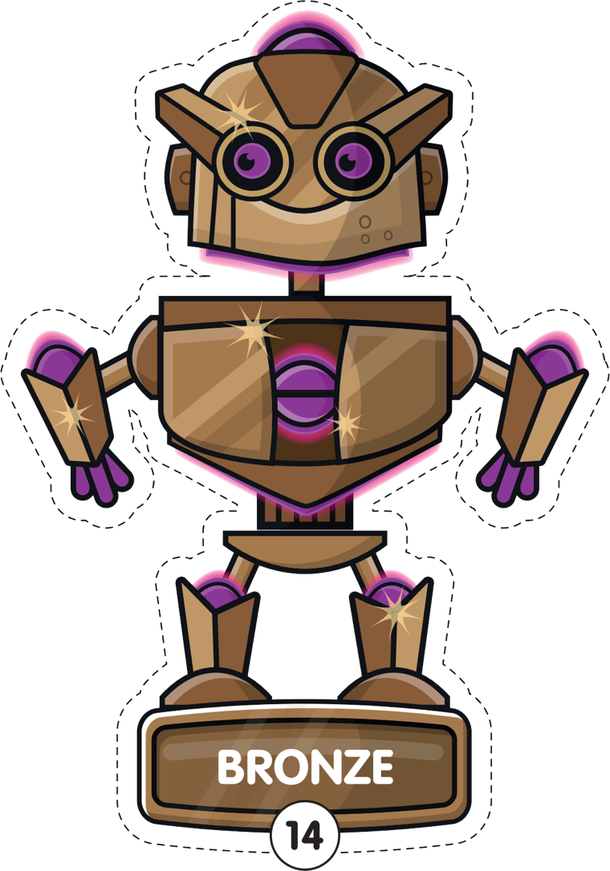






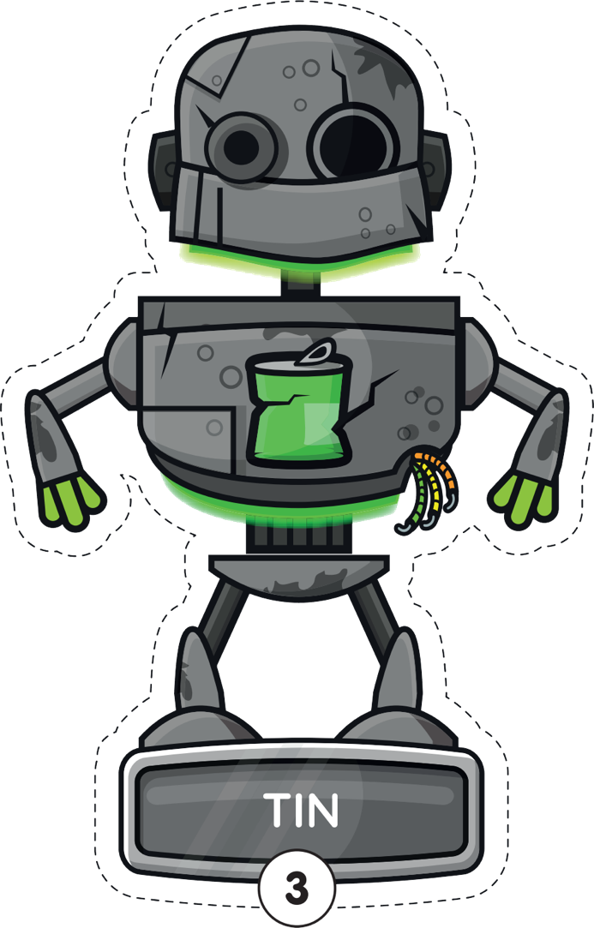
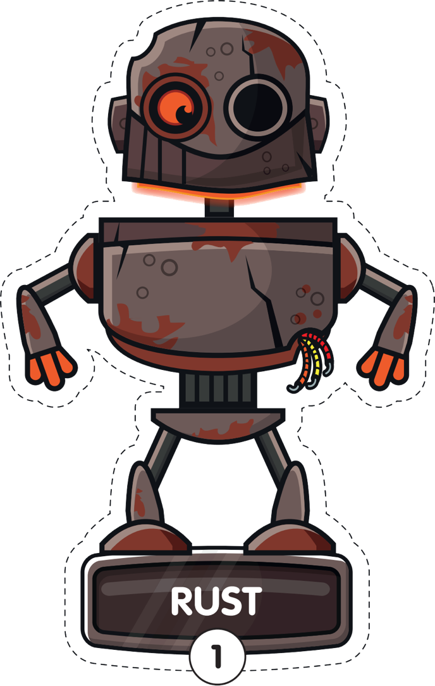





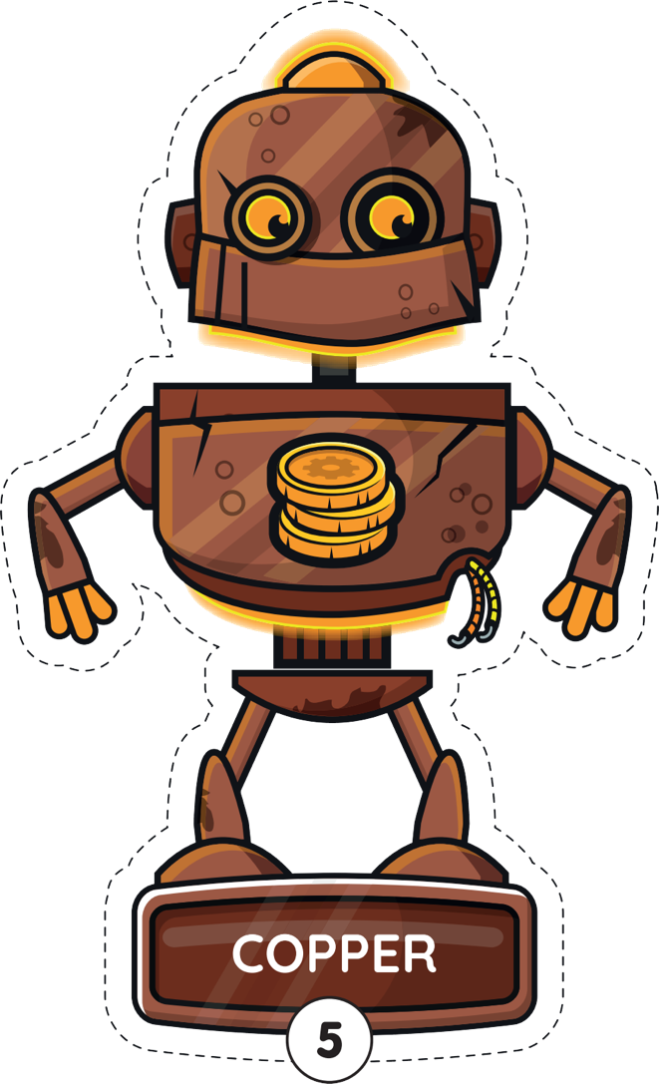

[Menu]
… so that he can transform into a Diamond!
Notes:
The full transformation from Rust to Diamond! Just for fun ☺
Feel free to skip this slide if you want to save time.

Slide 41
[Menu]
Now it is time for you to have a go!
Notes:
Leave this screen up while the children play.

Slide 42
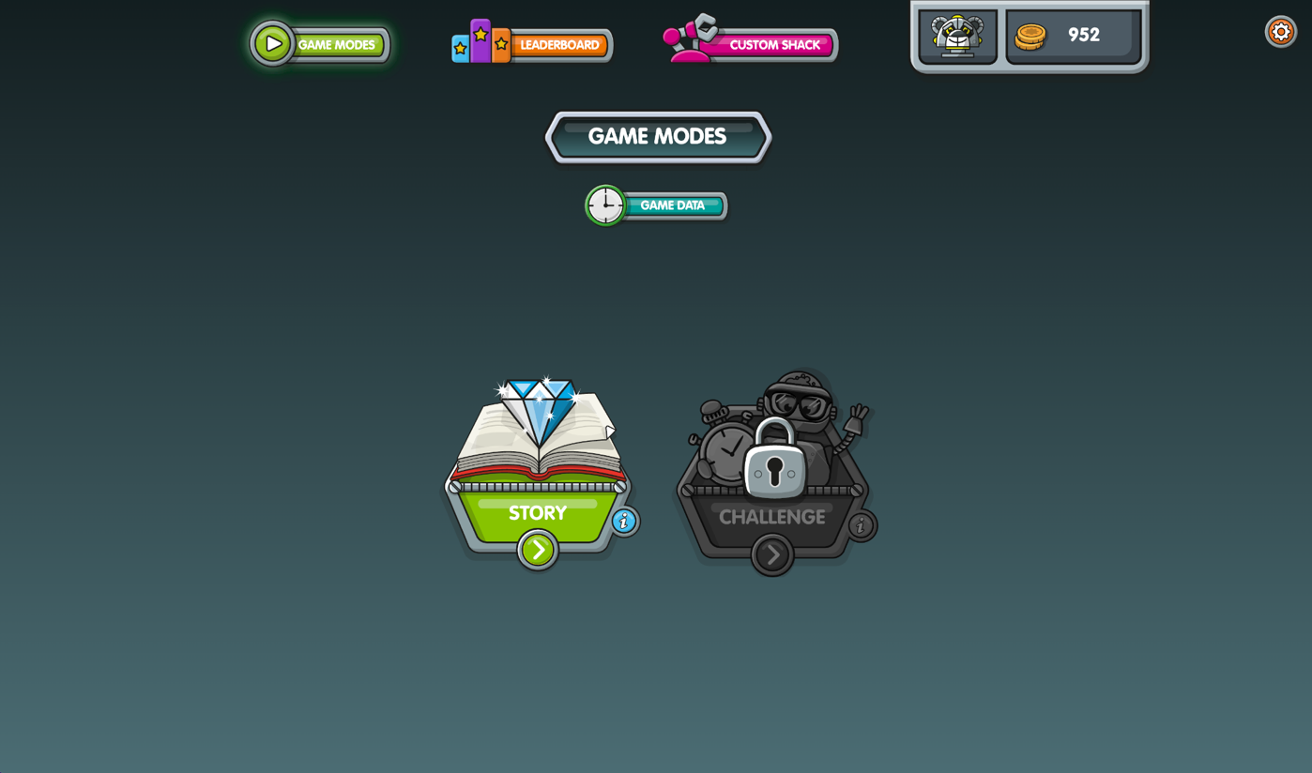
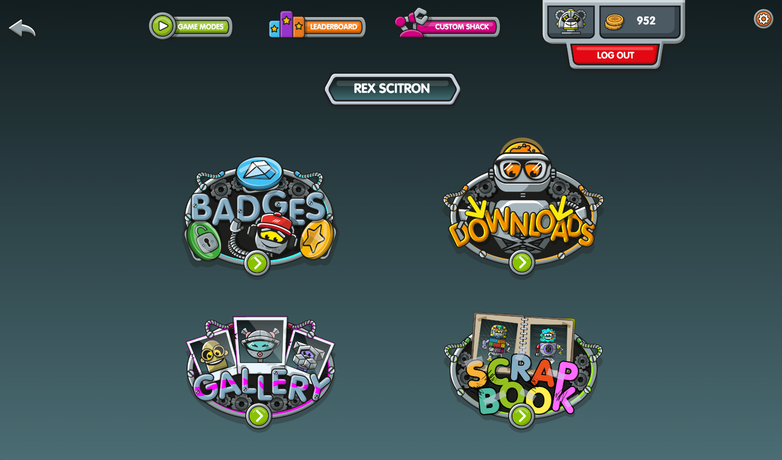
It’s time to log out!
[Menu]
First press
here…
… then press
here.
How to play
100
Notes:
It’s important that pupils log out of their account whenever they finish playing on a shared device.
Click on the image of your bot, at the top of the screen, then press the red “Log out” button.

Slide 43

[Menu]
32 skills to practise
Correctly answer as many as you can
How to play
Improves recall
Earn trophies for high scores
60 seconds
Notes:
Challenge mode is about speedy correct answers on different skills.
Remember, Challenge mode is locked to start with and can only be unlocked by getting to a certain point in Story mode.
You start in Challenge level 1. To unlock the next level, you need to correctly answer 12 questions in a minute.
Each game takes 1 minute. Answer as many questions as you can. Answer correctly in less than 3 seconds per question to earn bronze, silver and gold trophies.

Slide 44
[Menu]
Still to come…
Notes:
Towards the end of the session, after pupils have logged out of NumBots, you may want to reflect on the experience as a group and explain how the pupils will be using NumBots going forward.

Slide 45
[Menu]
How did you get on?
Did you enjoy NumBots?
Still to come
Notes:
Did anyone unlock the Custom Shack? Earn a badge? Earn an upgrade for Rusty? Change their bot in the Custom Shack?

Slide 46
[Menu]
There’s still lots more to discover on NumBots!
Still to come

Slide 47
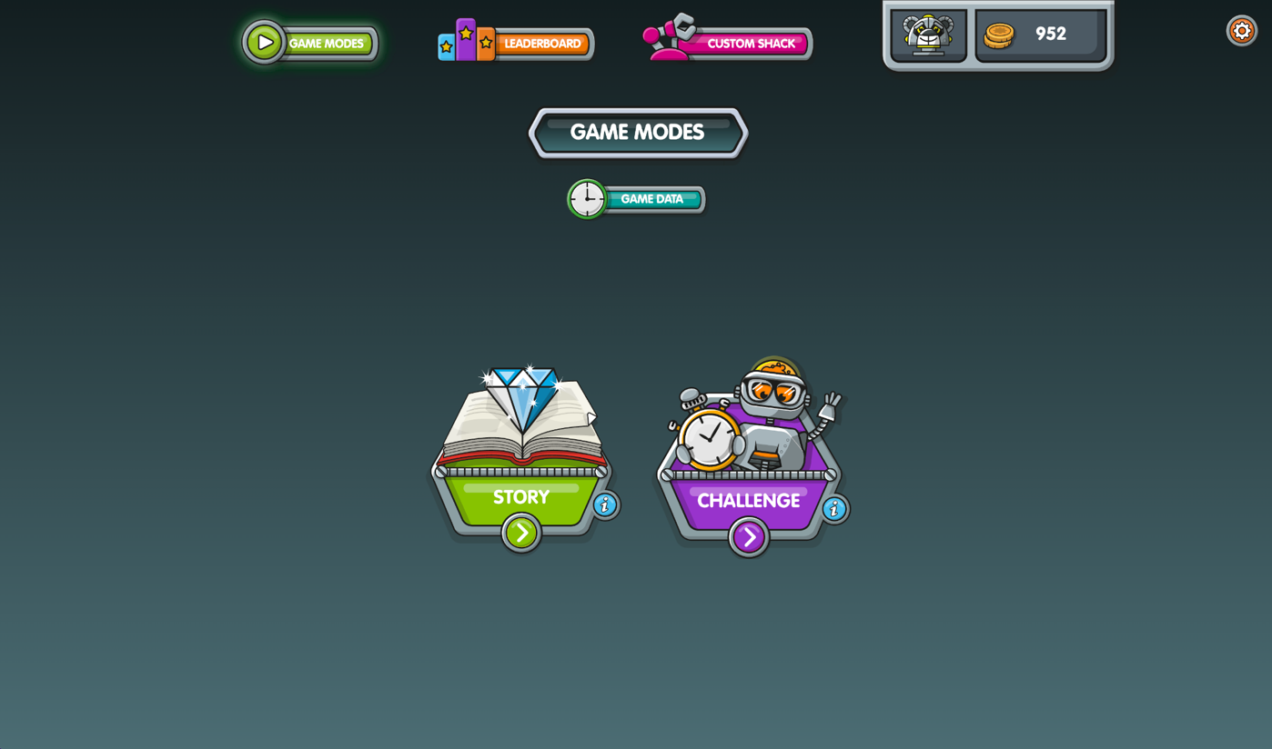
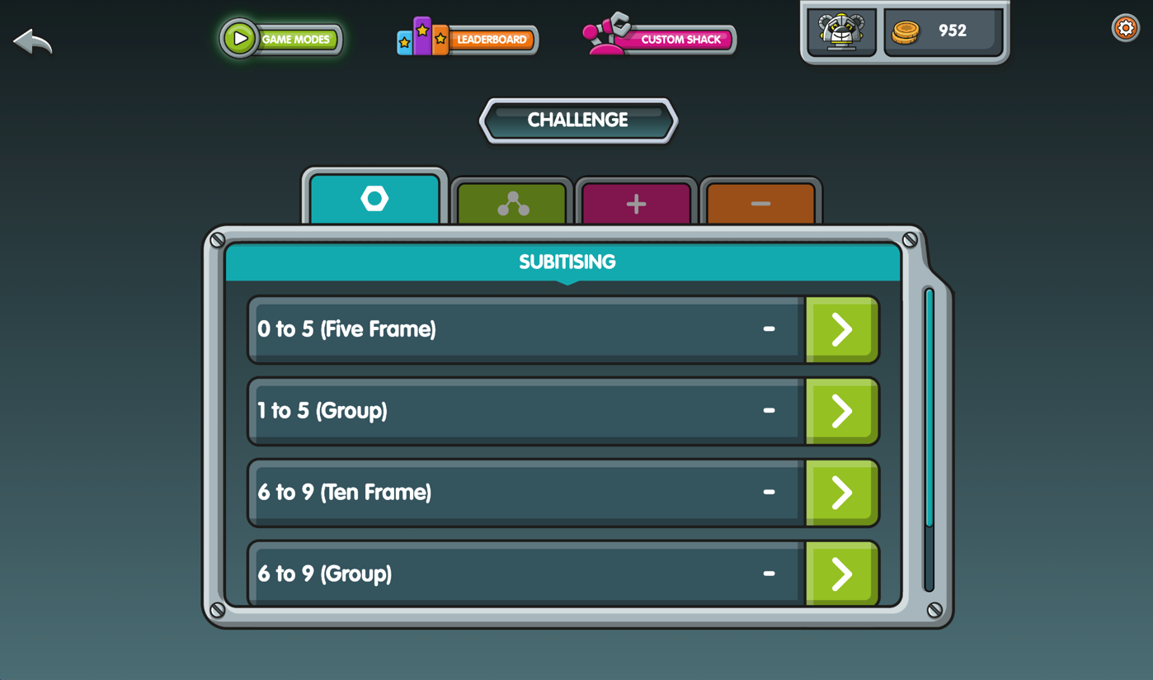

Unlock Challenge Mode…
[Menu]
… play Challenge games…
… and win trophies!
Still to come
100
Notes:
Once you reach Iron level 26 in Story mode, you’ll unlock “Challenge Mode”. There are 32 new games in Challenge mode. Click the green arrow to begin playing. Answer as many questions as you can in 1 minute and win trophies for high scores.

Slide 48
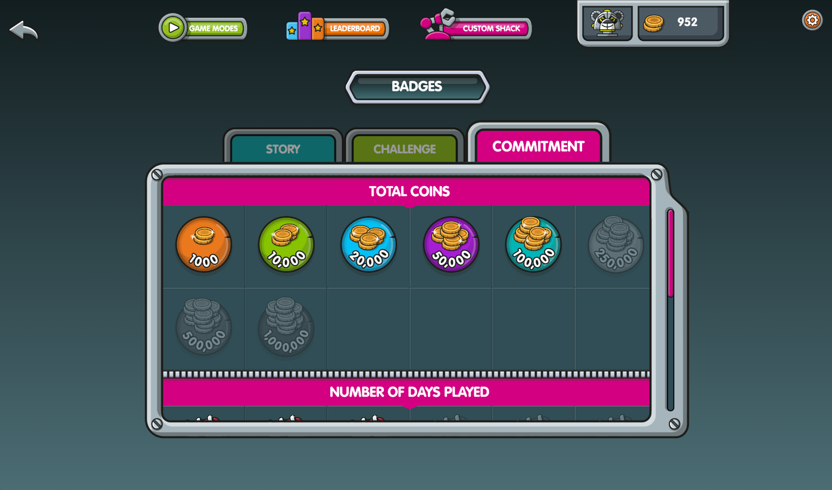
Collect badges
[Menu]
Still to come
100
Notes:
These are earned for completing certain milestones, like playing regularly or answering lots of questions correctly.

Slide 49
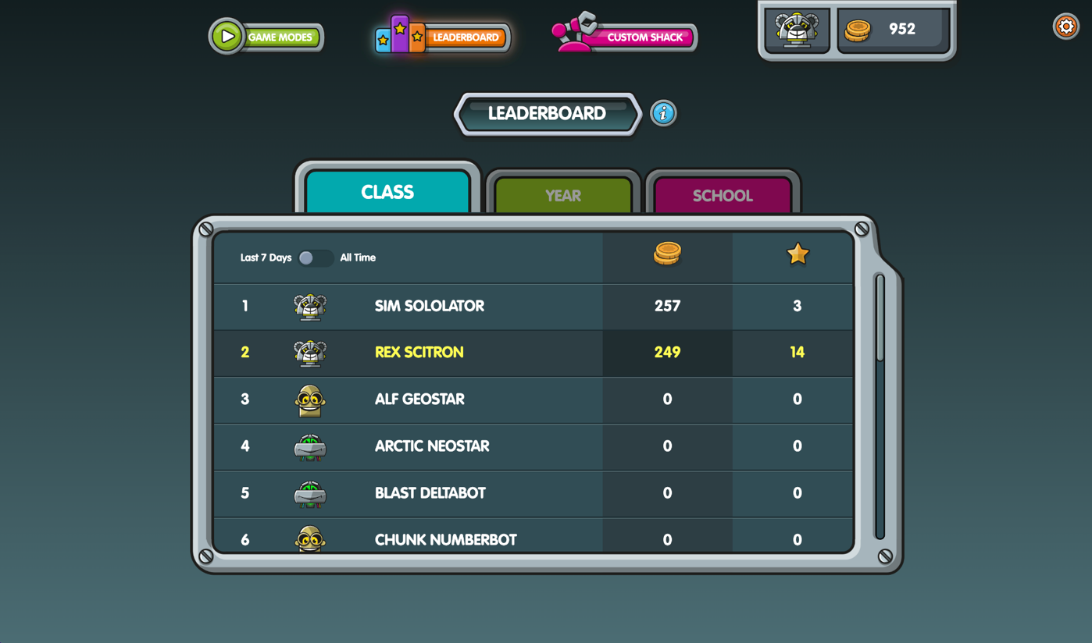
Appear on leaderboards
[Menu]
Still to come
100
Notes:
See how high up the pupil leaderboard you can get. Click on the star to order by number of stars, instead of coins. And switch the toggle across to view all time scores, instead of from the last 7 days.
Delete this slide if you have hidden the leaderboards.

Slide 50

Upgrade your Bot in the Custom Shack…
[Menu]
Still to come
100
Notes:
When you earn 800 coins, the Custom Shack will unlock. You can spend the coins you’ve earned to customise your Bot.

Slide 51

…and save your favourite designs in the Scrapbook
[Menu]
Still to come
100
Notes:
Click the “Add to Scrapheap” button in the Custom Shack to save up to 20 unique bots. Press the green arrow button to download and print your favourite creations.

Slide 52
Discover everything in the Inventory:
[Menu]
Press here to
open Inventory.
Still to come
100
Notes:
Click on the image of your bot, at the top of the screen, to access the Inventory. This acts as a menu so that you can easily access all the additional fun features.

Slide 53



We’ll also be awarding certificates!
[Menu]
Still to come
100
Notes:
Teacher to explain what they will be awarding certificates for and how often. (Delete this slide if you are not going to use the Certificate Hub to produce auto-populated certificates, recognising your pupils’ achievements.)

Slide 54
[Menu]
What are we learning?
Notes:
Feel free to skip this whole section if it’s not right for your audience.
It’s usually best to cover this once they’ve logged in and played on NumBots. We suggest coming back to this part of the slide deck after they’ve been playing a while, or even in a follow up lesson.

Slide 55












[Menu]
ADD & SUBTRACT
Learning Intentions
NUMBER BONDS
SUBITISING
100
Notes:
Feel free to skip this slide if you want to save time.
The three core strands of NumBots are subitising (“counting without counting”), number bonds and addition & subtraction. Here are some screenshots of the representations we use.

Slide 56
[Menu]
Why are we learning these things?
Learning Intentions
Notes:
Feel free to skip this slide if you want to save time.

Slide 57



[Menu]
Imagine maths was a house.
You start with subitising…
You can keep building higher…
Those are the foundations.
Next, is adding and subtracting.
… if you have strong walls and floors.
… and then number bonds.
Then even more fun stuff!
Learning Intentions
Even more fun stuff!
Adding & Subtracting
Number Bonds
Subitising
100
Notes:
Feel free to skip this slide if you want to save time.

Slide 58
[Menu]
Wahoo! Addition and subtraction solved!

Slide 59

[Menu]
Helping you and Rusty to shine like a diamond!

